Slide 1
Microservice with API Gateway
Binu Edwin

Slide 2
Agenda
Introduction
Architecture
Infrastructure
Advantages
Code example

Slide 3
Introduction
Microservices:
In a microservices architecture, each component or service focuses on a specific business functionality.
Services are independent, have their own databases, and communicate through well-defined APIs.
Services are developed, deployed, and scaled independently, allowing for easier maintenance and flexibility.
API Gateway:
An API Gateway is a centralized entry point for external clients (such as web, mobile apps, or other services) to interact with the microservices.
It provides features like authentication, authorization, request routing, load balancing, caching, and more.
The API Gateway can aggregate multiple requests into a single one to reduce the number of calls to different services.
It can also handle API versioning and provide consistent API contracts to clients.

Slide 4
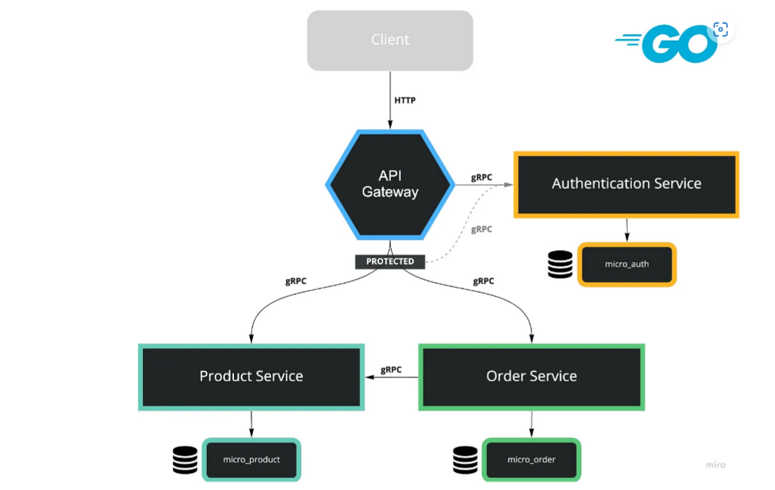
Application Architecture

Slide 5
Application Infrastructure
API Gateway: Handles incoming HTTP requests
Auth Service: Provides features such as Register, Login and generates Token by JWT
Product Service: Provides features such as Add Product, Decrease Stock and Find Product
Order Service: The only feature we ship in this Microservice is Create Order

Slide 6
Advantages:
Simplified client access: Clients only need to interact with the API Gateway instead of directly connecting to each microservice.
Security and access control: The API Gateway can handle authentication and authorization, ensuring only authorized clients access specific services.
Load balancing: Requests are distributed to different instances of microservices to ensure optimal resource utilization.
Monitoring and analytics: The API Gateway can collect data on API usage, helping to analyze performance and troubleshoot issues.
Simplified versioning: API Gateway can manage different versions of microservices without impacting client applications.
Overall, the API Gateway acts as a single point of entry for clients, providing a unified and consistent interface while abstracting the complexity of the underlying microservices. Popular tools for implementing API Gateways include NGINX, Kong, Apigee, and AWS API Gateway.

Slide 7
Example
Here's a simple example of how you might structure a microservices architecture using gRPC in Go, along with an API Gateway to manage client communication:
1. Define Protobuf Messages and Services:
Create .proto files to define your service interfaces and messages. For example, let's consider a simple user management system with two microservices, UserService and AuthService.
// auth_service.proto
syntax = "proto3";
service AuthService {
rpc Authenticate(AuthRequest) returns (AuthResponse);
}
message AuthRequest {
string username = 1;
string password = 2;
}
message AuthResponse {
bool success = 1;
string token = 2;
}
// user_service.proto
syntax = "proto3";
service UserService {
rpc GetUser(UserRequest) returns (UserResponse);
}
message UserRequest {
string user_id = 1;
}
message UserResponse {
string user_id = 1;
string username = 2;
}

Slide 8
-> Implement Microservices:
Implement the gRPC services for each microservice based on the defined .proto files.
-> Implement API Gateway:
Create an API Gateway that handles client communication and forwards requests to the appropriate microservices.
package main
import (
"log"
"net/http"
"github.com/grpc-ecosystem/grpc-gateway/runtime"
"golang.org/x/net/context"
"google.golang.org/grpc"
gw "path/to/protobuf" // Import your generated protobuf code
)
func main() {
ctx := context.Background()
mux := runtime.NewServeMux()
opts := []grpc.DialOption{grpc.WithInsecure()}
err := gw.RegisterUserServiceHandlerFromEndpoint(ctx, mux, "localhost:50051", opts)
if err != nil {
log.Fatal(err)
}
err = gw.RegisterAuthServiceHandlerFromEndpoint(ctx, mux, "localhost:50052", opts)
if err != nil {
log.Fatal(err)
}
http.ListenAndServe(":8080", mux)
}

Slide 9
-> Run the Services and Gateway:
Run your gRPC microservices (UserService and AuthService) and the API Gateway. The API Gateway will serve as the entry point for clients to access the services.
-> Client Interaction:
Clients can now make HTTP requests to the API Gateway, which translates the requests to gRPC calls to the respective microservices.
Remember to replace "path/to/protobuf" with the actual import path for your generated protobuf code and adjust the service names, endpoints, and other details according to your application's architecture.
This example demonstrates a basic setup of microservices with gRPC and an API Gateway in Go. Depending on your application's complexity and requirements, you may need to implement additional features like load balancing, authentication, and more.

Slide 10
Thank You

